Slide 1
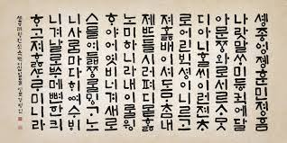
Multi Class Imbalanced Techniques
Data Preprocessing Method
Algorithm Level Approaches
Cost Sensitive Learning Methods
Ensemble Methods
Notes:
<숫자>

Slide 2
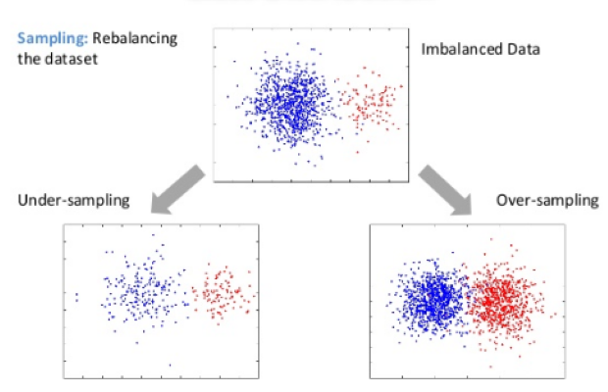
Data Preprocessing Methods
The data preprocessing techniques that try to balance the given samples before train the classifier
Resampling
Oversampling Techniques
- add data samples in the minority class
Undersampling Techniques
- remove some data samples from the majority class
https://medium.com/quantyca/oversampling-and-undersampling-adasyn-vs-enn-60828a58db39

Slide 3
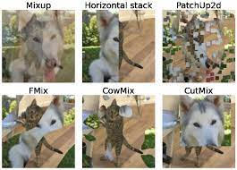
Data Preprocessing Methods
The data preprocessing techniques that try to balance the given samples before train the classifier
Augmentation
Pixel-Level Transforms
- Blur, Jitter, Noise
Spatial-Level Transforms
- Flip, Rotation
Mix Transforms
Year | Paper
2018 | Improved Mixed-Example Data Augmentation
2018 | MixUp: Beyond Empirical Risk Minimization
2018 | Data Augmentation using Random Image Cropping and Patching for Deep CNNs
2019 | Cutmix, Augmix
2020 | Smoothmix, Puzzlemix

Slide 4
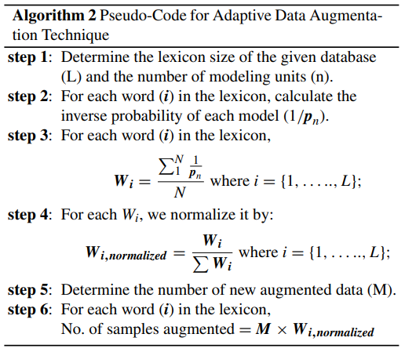
Algorithm Level Approaches
Adjust the learning toward the minority class by creating or modifying the typical machine learning algorithm
ML perspective
Hierarchical SVM, Logistic Regression, etc …
Related Paper
Exploring Deep Learning Approaches to Recognize
Handwritten Arabic Texts
Year | 2020
Contribute | Adaptive data augmentation algorithm to promote class diversity
Method | Weight assignment according to the frequency of words

Slide 5
Cost Sensitive Learning Methods
How to devise a cost matrix and how to associate it with the algorithm
Class Imbalance Problem in Data Mining
Minimizing misclassification cost
Add cost function to FN and FP
Giving FN more cost than FP in order to not to miss more minority class
Solve imbalanced learning problems using a cost matrix that accounts for misclassified costs
How to apply in image classification?
$TotalCost=C\left(FP\right)∗FN+C\left(FP\right)∗FP$

Slide 6
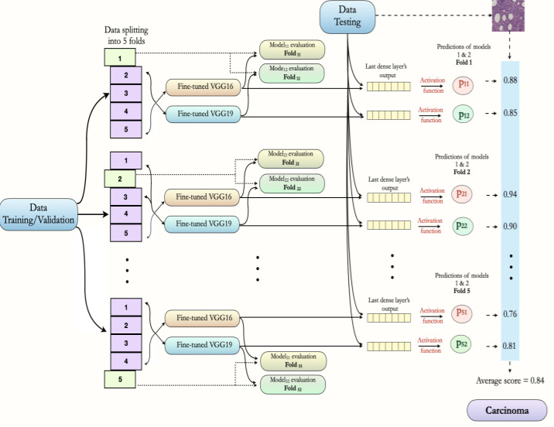
Ensemble Methods
Hybrid techniques like combining ensemble learning with sampling
Related Paper
Mainly used in the medical, industry
Prevent overfitting
Binary classification
Year | Paper
2019 | Deep learning Ensemble for Hyperspectral Image Classification
2019 | The Relative Performance of Ensemble Methods with DCNN for image classification
2020 | Breast Cancer Histopathology Image Classification Using an Ensemble of Deep Learning Models

Slide 7
Motivation
Augmentation & Ensemble Methods
Augmentation Goal : Convert from 1 to 50
Pixel Level Transforms
GAN Transforms
Modeling Goal : Ensemble Model approach
Find methods
Albumentations – fast image augmentation library

Slide 8
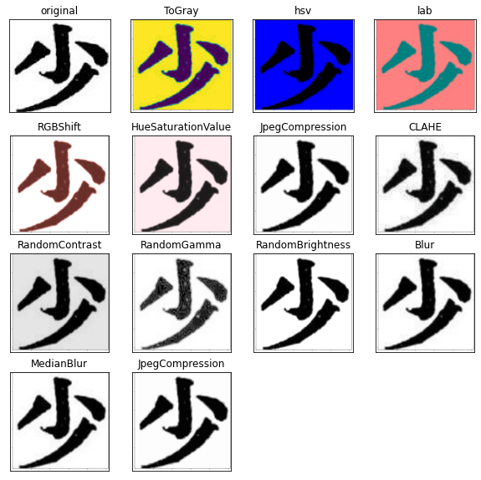
Approach
Augmentation & Ensemble Methods
Augmentation Pixel–Level Transforms
Convert from 1 to 10~15
Difference of Aug data and Original Data
Albumentations – fast image augmentation library

Slide 9
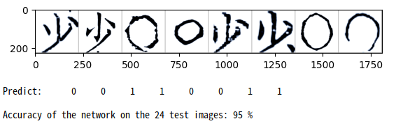
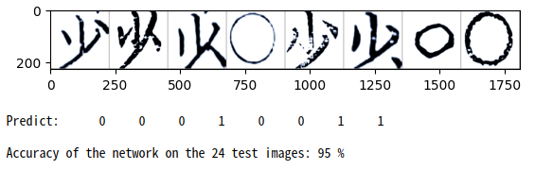
Experiments
Augmentation & Ensemble Methods
Result
Binary Classification
Model – Resnet101
Data size : 10
It depends on the number of data
Aug and Original are similar
ORIGINAL
Augmentation
Albumentations – fast image augmentation library

Slide 10
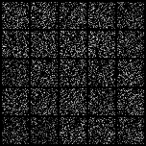
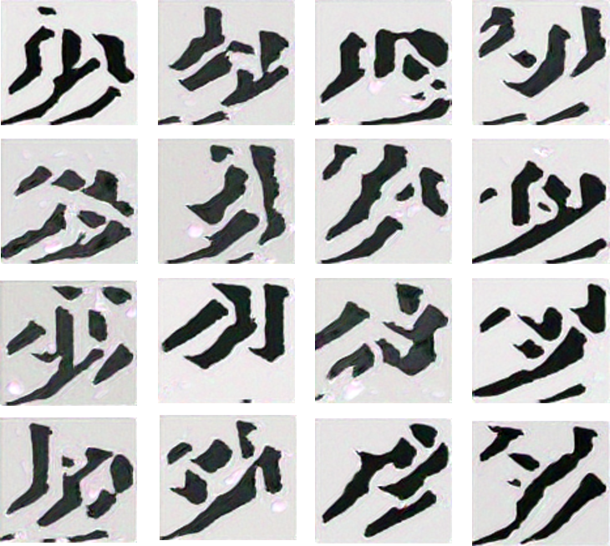
Approach
Augmentation & Ensemble Methods
Augmentation GAN
1. GAN Augmentation
PGGAN to augment data and train CNN models
Required large dataset
GAN Augmentation: Augmenting Training Data using Generative Adversarial Networks
2. SINGAN Augmentation
Learn enough information to create an image from one image
ICCV 2019 Best paper

Slide 11
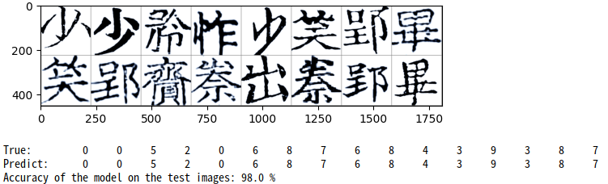
Experiments
Augmentation & Ensemble Methods
Result
Binary Classification
Model – Resnet101
Data size : 50
Real :15 Fake : 25

Slide 12
Approach
Augmentation & Ensemble Methods
Ensemble
N classifiers with 50 datasets
Duplicate data
Model selection
Algorithm level, cost sensitive learning application

Slide 13
Problem
Question & Answer
Duplicates character of augmented data
Minimum of data for training
Different approach for imbalance data

Slide 14
Thank you
김명휘

